Slide 1
AI for Medicine
Lecture 1: Introduction
January 10, 2022
Mohammad Hammoud
Carnegie Mellon University in Qatar

Slide 2
Outline
Introduction
What is AI?
Administrivia
AI Applications in Medicine

Slide 3
On the Verge of Major Breakthroughs
Artificial Intelligence (AI) has been moving extremely quickly in the last few years, demonstrating a potential to revolutionize every aspect of our lives
Work
Economy
Medicine
Mobility

Slide 4
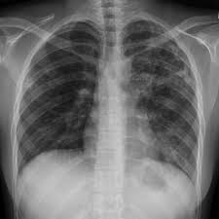
But, What is AI?
AI can be broadly defined as technology that can learn and produce intelligent behavior
Input
Output
An AI Process
Pixels:
“Tuberculosis”
Computer Vision

Slide 5
But, What is AI?
AI can be broadly defined as technology that can learn and produce intelligent behavior
Input
Output
An AI Process
“Four kids are playing with a ball”
Pixels:
More than just a category about the image!
Computer Vision

Slide 6
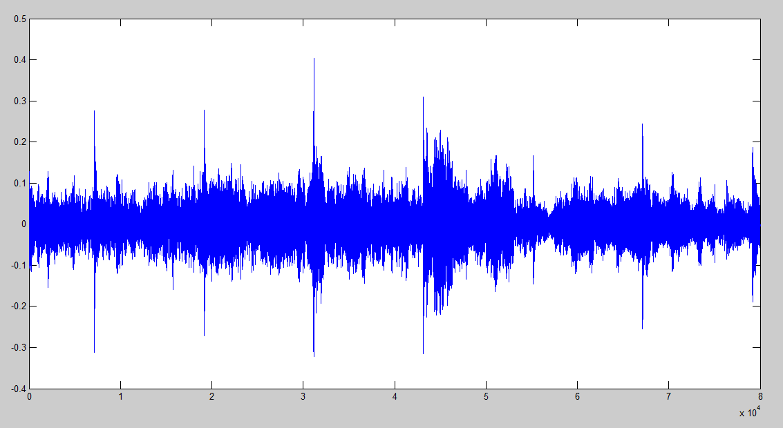
But, What is AI?
AI can be broadly defined as technology that can learn and produce intelligent behavior
Input
Output
An AI Process
Audio Clip:
“I feel some eye pain”
Speech Recognition

Slide 7
But, What is AI?
AI can be broadly defined as technology that can learn and produce intelligent behavior
Input
Output
An AI Process
Text:
“Hello, how are you?”
“Bonjour, comment allez-vous”
Machine Translation

Slide 8
But, What is AI?
Think of this as incoming impulses (input) passed from one neuron (AI process) to the next, if any, and finally generating an output
Input
Output
AI process, which is essentially a mathematical function-- more on this next week

Slide 9
But, What is AI?
You can connect as many of these neurons as needed, resulting in what is called a neural network (a branch of AI)
The more layers you add, the deeper it becomes. Deep ones are referred to as deep neural networks or deep learning (DL) models

Slide 10
But, What is AI?
Subsequently, you can train your DL model
Pneumonia
Tuberculosis
Tuberculosis
Example 1

Slide 11
But, What is AI?
Again, with a different known example
Pneumonia
Tuberculosis
Tuberculosis
Example 2

Slide 12
But, What is AI?
Yet again, with yet another different known example
Pneumonia
Tuberculosis
Tuberculosis
Repeat until it learns the patterns
of Tuberculosis (and Pneumonia) in
input images
Example 3

Slide 13
But, What is AI?
After training your DL model, you can use it to infer what an unknown image may show
Pneumonia
Tuberculosis
Tuberculosis
?

Slide 14
But, What is AI?
DL is just a branch of machine learning, which is a branch of AI
Deep Learning (DL)
Machine Learning (ML)
Artificial Intelligence (AI)
AI
ML
DL
Computer Science
Math
Physics
Chemistry
Biology

Slide 15
Outline
Introduction
What is AI?
Administrivia
AI Applications in Medicine

Slide 16
Objectives
This course will:
Demystify major AI concepts for you (e.g., machine learning, neural networks, Bayesian networks, etc.,)
Take you through a journey of AI applications in medicine
Allow you to navigate several societal issues and ethical concerns that surround AI

Slide 17
Learning Outcomes
After finishing the course, you will be able to:
LO # | Description
1 | Define AI and discuss what AI can and cannot do
2 | Recognize various AI applications in medicine and describe how they are transforming healthcare
3 | Appreciate the power of big data in enabling AI and describe the different types of data representations
4 | Recognize the power of AI algorithms in solving medical problems and discuss how they can be applied in the medical field
5 | Describe different AI concepts, including machine learning, deep learning, recommendation systems, ranked retrievals, and probabilistic graphical models, among others
6 | Apply some AI techniques to solve real-world medical problems (only for 15-282 students)
7 | Discuss several societal issues and ethical concerns surrounding AI
LO # | Description
1 | Define AI and discuss what AI can and cannot do
2 | Recognize various AI applications in medicine and describe how they are transforming healthcare
3 | Appreciate the power of big data in enabling AI and describe the different types of data representations
4 | Recognize the power of AI algorithms in solving medical problems and discuss how they can be applied in the medical field
5 | Describe different AI concepts, including machine learning, deep learning, recommendation systems, ranked retrievals, and probabilistic graphical models, among others
6 | Apply some AI techniques to solve real-world medical problems (only for CMU-Q students)
7 | Discuss several societal issues and ethical concerns surrounding AI
LO # | Description
1 | Define AI and discuss what AI can and cannot do
2 | Recognize various AI applications in medicine and describe how they are transforming healthcare
3 | Appreciate the power of big data in enabling AI and describe the different types of data representations
4 | Recognize the power of AI algorithms in solving medical problems and discuss how they can be applied in the medical field
5 | Describe different AI concepts, including machine learning, deep learning, recommendation systems, ranked retrievals, and probabilistic graphical models, among others
6 | Apply some AI techniques to solve real-world medical problems (only for 15-282 students)
7 | Discuss several societal issues and ethical concerns surrounding AI
LO # | Description
1 | Define AI and discuss what AI can and cannot do
2 | Recognize various AI applications in medicine and describe how they are transforming healthcare
3 | Appreciate the power of big data in enabling AI and describe the different types of data representations
4 | Recognize the power of AI algorithms in solving medical problems and discuss how they can be applied in the medical field
5 | Describe different AI concepts, including machine learning, deep learning, recommendation systems, ranked retrievals, and probabilistic graphical models, among others
6 | Apply some AI techniques to solve real-world medical problems (only for CMU-Q students)
7 | Discuss several societal issues and ethical concerns surrounding AI
LO # | Description
1 | Define AI and discuss what AI can and cannot do
2 | Recognize various AI applications in medicine and describe how they are transforming healthcare
3 | Appreciate the power of big data in enabling AI and describe the different types of data representations
4 | Recognize the power of AI algorithms in solving medical problems and discuss how they can be applied in the medical field
5 | Describe different AI concepts, including machine learning, deep learning, recommendation systems, ranked retrievals, and probabilistic graphical models, among others
6 | Apply some AI techniques to solve real-world medical problems (only for CMU-Q students)
7 | Discuss several societal issues and ethical concerns surrounding AI
LO # | Description
1 | Define AI and discuss what AI can and cannot do
2 | Recognize various AI applications in medicine and describe how they are transforming healthcare
3 | Appreciate the power of big data in enabling AI and describe the different types of data representations
4 | Recognize the power of AI algorithms in solving medical problems and discuss how they can be applied in the medical field
5 | Describe different AI concepts, including machine learning, deep learning, recommendation systems, ranked retrievals, and probabilistic graphical models, among others
6 | Apply some AI techniques to solve real-world medical problems (only for CMU-Q students)
7 | Discuss several societal issues and ethical concerns surrounding AI
LO # | Description
1 | Define AI and discuss what AI can and cannot do
2 | Recognize various AI applications in medicine and describe how they are transforming healthcare
3 | Appreciate the power of big data in enabling AI and describe the different types of data representations
4 | Recognize the power of AI algorithms in solving medical problems and discuss how they can be applied in the medical field
5 | Describe different AI concepts, including machine learning, deep learning, recommendation systems, ranked retrievals, and probabilistic graphical models, among others
6 | Apply some AI techniques to solve real-world medical problems (only for CMU-Q students)
7 | Discuss several societal issues and ethical concerns surrounding AI

Slide 18
Structure
The course has two versions:
15-182: 6 units, no project, and only 1 lecture per week
15-282: 9 units, 1 big project, and 2 lectures per week
Three main teaching tools will be used: Zoom, Piazza, and Gradescope
No textbook is required
Slides will be self-contained, but you are encouraged to take notes
All material will be posted on the course website
There will be 7 CAs (contacts and office hours are on the website)

Slide 19
Assessment Methods
How will we measure learning?
Type | # | Weight
Homework Assignments | 4 | 40% for 15-182 and 20% for 15-282
Quizzes | 2 | 20% for 15-182 and 15% for 15-282
Exams | 2 | 35%
Project (only for 15-282) | 1 | 25% for 15-282
Attendance and Participation | 13 for 15-182 and 26 for 15-282 | 5%

Slide 20
Outline
Introduction
What is AI?
Administrivia
AI Applications in Medicine

Slide 21
Some Applications of AI in Medicine
Diagnosing diabetic eye disease using deep learning [1]
Detecting anemia from retinal fundus images using deep learning [2]
Predicting cardiovascular risk factors from retinal fundus photographs using deep learning [3]
Performing differential diagnosis using probabilistic graphical models [4]
Extracting symptoms and their status from clinical conversations using recurrent neural networks [5]
Predicting osteoarthritis using machine learning [6]

Slide 22
Some Applications of AI in Medicine
Diagnosing diabetic eye disease using deep learning [1]
Detecting anemia from retinal fundus images using deep learning [2]
Predicting cardiovascular risk factors from retinal fundus photographs using deep learning [3]
Performing differential diagnosis using probabilistic graphical models [4]
Extracting symptoms and their status from clinical conversations using recurrent neural networks [5]
Predicting osteoarthritis using machine learning [6]

Slide 23
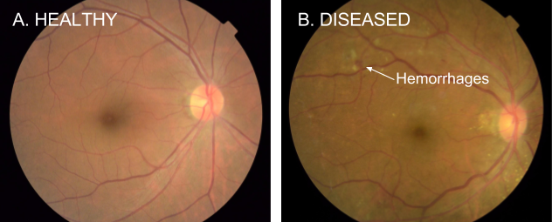
Diagnosing Diabetic Eye Disease Using Deep Learning
Diabetic retinopathy (DR) is the fastest growing cause of blindness, with nearly 451 million diabetic patients at risk worldwide
One of the most common ways to detect DR is to have a specialist examine eye pictures and rate them for disease presence and severity

Slide 24
Diagnosing Diabetic Eye Disease Using Deep Learning
If DR is caught early, the disease can be treated; if not, it can lead to irreversible blindness
As such, regular screening is essential for the early detection of DR
Unfortunately, medical specialists capable of detecting DR are not available in many parts of the world where diabetes is prevalent
Google has developed a deep learning algorithm capable of interpreting signs of DR in retinal photographs

Slide 25
Diagnosing Diabetic Eye Disease Using Deep Learning
They created a dataset of 128,000 images, each labeled by 3-7 ophthalmologists from a panel of 54 ophthalmologists
DR severity (none, mild, moderate, severe, or proliferative) was graded according to the International Clinical Diabetic Retinopathy scale
They then used this dataset to train a deep learning algorithm to detect referable diabetic retinopathy
Afterwards, they tested the algorithm on two clinical validation sets totaling ~12,000 images, with a panel of 7-8 U.S. board-certified ophthalmologists serving as the reference standard
Notes:
The ophthalmologists selected for the validation sets were the ones that showed high consistency from the original group of 54 doctors.

Slide 26
Diagnosing Diabetic Eye Disease Using Deep Learning
The F-score (combined sensitivity and specificity) of the algorithm was 0.95, which is slightly better than the median F-score of the 8 board-certified ophthalmologists (measured at 0.91)
What does that mean?
AI can now offer an automated system for DR detection with
Very high accuracy
Near instantaneous reporting of results!
Consistency of interpretation (the algorithm will make the same prediction on a specific image every time)

Slide 27
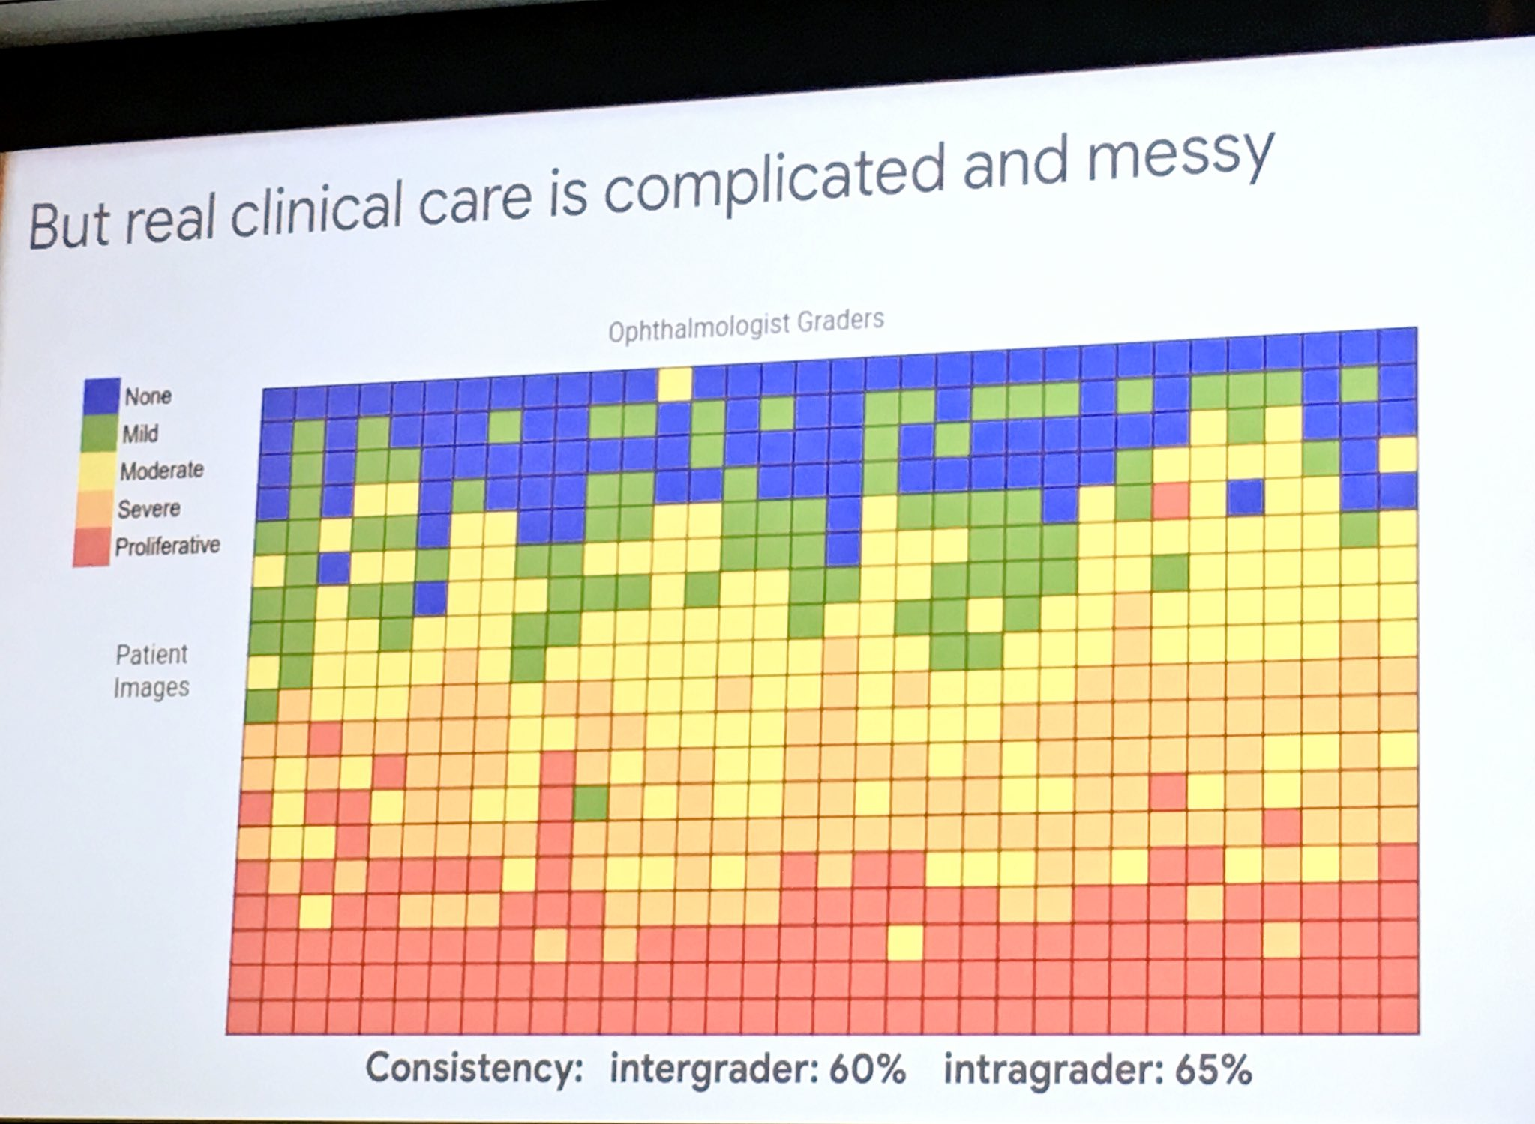
Diagnosing Diabetic Eye Disease Using Deep Learning
A slide from Jeff Dean’s Keynote in 2019 at the “Big Data in Precision Health” conference at Stanford Medicine

Slide 28
Some Applications of AI in Medicine
Diagnosing diabetic eye disease using deep learning [1]
Detecting anemia from retinal fundus images using deep learning [2]
Predicting cardiovascular risk factors from retinal fundus photographs using deep learning [3]
Performing differential diagnosis using probabilistic graphical models [4]
Extracting symptoms and their status from clinical conversations using recurrent neural networks [5]
Predicting osteoarthritis using machine learning [6]
Next week on Monday …

Slide 29
Thank you!

Slide 30
References
Gulshan, Varun, et al. "Development and validation of a deep learning algorithm for detection of diabetic retinopathy in retinal fundus photographs." Jama 316.22 (2016): 2402-2410.
Mitani, Akinori, et al. "Detection of anaemia from retinal fundus images via deep learning." Nature Biomedical Engineering 4.1 (2020): 18-27.
Poplin, R., et al. "Predicting cardiovascular risk factors from retinal fundus photographs using deep learning. arXiv 2017." arXiv preprint arXiv:1708.09843.
https://rimads.ai/avey/
Du, Nan, et al. "Extracting symptoms and their status from clinical conversations." arXiv preprint arXiv:1906.02239 (2019).
Kundu, Shinjini, et al. "Discovery and visualization of structural biomarkers from MRI using transport-based morphometry." NeuroImage 167 (2018): 256-275.

